Slide 1
XM - Plus Studio Chamber Test
internal
Application Department
Wesley Chen

Slide 2
Outline
Application Note
How to build XM Chamber Test Environment
Equipment
Schematic diagraph of Connecting
Introduce how to use XM Display Studio to implement Chamber Test
Introduce chamber test script file ( .txt )
How to open XM Display Studio Tool for chamber test
Check Instrument Status
Chamber test

Slide 3
Equipment
Chamber Test will need some Equipment such as Meters 、Power supply、Chamber machine and so on, as below.
Chamber machine： 1 set
XM Bridge-Board ：1 set
Relay Board : 1 set
PC or Notebook : 1 set
Power supply : 1 set
Meter : 2 sets ( one is Current measure , another is Voltage measure .)

Slide 4
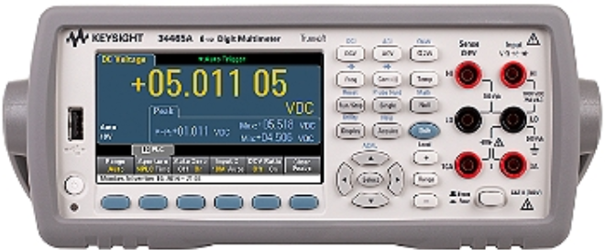
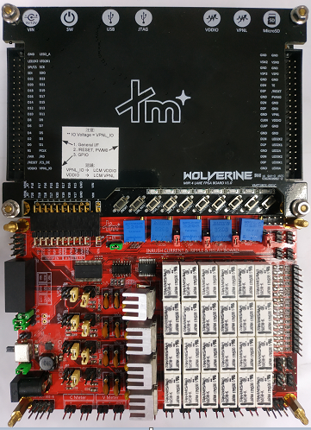
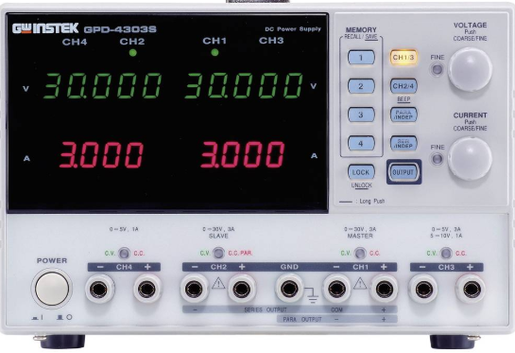
Schematic diagraph of Connecting - 1
Schematic diagraph as below.
Chamber machine
Set Current Measure ( 1A )
COG
(COB)
MIPI、Reset、LED0A
、LED0K1 and GND
Set Voltage Measure
Power Supply
Voltage Measure
( VDDIO、 AVDD 、AVEE 、VREF GVDDP、 GVDDN、 and so on. )
Current Measure
( VDDIO、 AVDD、 AVEE )
GND
VDDID
AVDD
AVDD
AVEE
VDDIO
AVEE

Slide 5
Schematic diagraph of Connecting - 2
In order to check environment is ok before Chamber testing, we can run in the platform which
is COG ( chip on glass ) or COB ( Chip on board ), Confirm normal display on the COG after
Sending script command( initial command ) is necessary and important. Next, XM display studio
( Tool ) can run chamber test without chamber machine, we can check contents ( Measure Data )
of the excel file whether it meets expectations, if yes, then start to run chamber test In the
chamber machine, otherwise Please check Script command for chamber test and connect
whether correct.
Note : Voltage measure support maximum is 15 sets.
Current measure support maximum is 3 sets.

Slide 6
Introduce chamber test script file ( .txt ) - 1
in order to keep elasticity for each chamber test, then We can modify file ( .txt ) to match each chamber
test. How to modify file in detail is very important, as below.
1. XM display studio support Command set ,as below
a). [TEMPERATURE SET] stands for set temperature values to chamber test
, if there are three temperature vales( -3, +10, +20 ), for example.
[TEMPERATURE SET]
-3
+10
+20
Item
[TEMPERATURE SET]
[INSTRUMENT SET]
[POWER SETX]
[FPGA SET]
[DISPLAY INITIAL CODE]
[DISPLAY OFF]
[SLEEP IN]
[SLEEP OUT]
[DISPLAY ON]
[CMD SETX]
[IMAGE CMD SETX]
[IMAGE SHOW]

Slide 7
Introduce chamber test script file ( .txt ) - 2
in order to keep elasticity for each chamber test, then We can modify file ( .txt ) to match each chamber
test. How to modify file in detail is very important, as below.
1. XM display studio support Command set ,as below
b). [INSTRUMENT SET] stands for change instrument(Power supply)
alias name to new name by user defined for example.
[INSTRUMENT SET]
instr.define ASRL3::INSTR PowerSupply
Item
[TEMPERATURE SET]
[INSTRUMENT SET]
[POWER SETX]
[FPGA SET]
[DISPLAY INITIAL CODE]
[DISPLAY OFF]
[SLEEP IN]
[SLEEP OUT]
[DISPLAY ON]
[CMD SETX]
[IMAGE CMD SETX]
[IMAGE SHOW]
Only alias name(Fixed)
By user defined

Slide 8
Introduce chamber test script file ( .txt ) - 3
in order to keep elasticity for each chamber test, then We can modify file ( .txt ) to match each chamber
test. How to modify file in detail is very important, as below.
1. XM display studio support Command set ,as below
c). [POWER SETX] stands for set power supply Voltage and Current limit
Modify by user defined for example.
[POWER SETX]
instr.send PowerSupply VSET3:1.8
instr.send PowerSupply VSET1:5.5
instr.send PowerSupply VSET2:5.5
instr.send PowerSupply ISET3:0.09
instr.send PowerSupply ISET1:0.09
instr.send PowerSupply ISET2:0.09
instr.send PowerSupply OUT1
Item
[TEMPERATURE SET]
[INSTRUMENT SET]
[POWER SETX]
[FPGA SET]
[DISPLAY INITIAL CODE]
[DISPLAY OFF]
[SLEEP IN]
[SLEEP OUT]
[DISPLAY ON]
[CMD SETX]
[IMAGE CMD SETX]
[IMAGE SHOW]
X Range from 1 to 8
Set voltage values
Set current values
Voltage output

Slide 9
Introduce chamber test script file ( .txt ) - 4
in order to keep elasticity for each chamber test, then We can modify file ( .txt ) to match each chamber
test. How to modify file in detail is very important, as below.
1. XM display studio support Command set ,as below
d). [FPGA SET] means set FPGA timing 、FPGA interface Backlight (LED)
and so on, for example.
[FPGA SET]
#PLL_EN ; EPP_EN ; I/F_mode1 ; I/F_mode2 ; DCM_m ; DCM_d
fpga.set 0x33 0x11 0x13 0xff 67 60
#Bridge select 0x01=Bank0(Left) 0x10=Bank2(Right)
bridge.select 0x01
#VA ; HA ; FR ; VBP ; VFP ; HBP ; HFP ; VS ; HS
mipi.video 1334 750 60 4 540 0 2 3 6
#Lane Num ; HS speed ; HS mode
mipi.dsi 2 1000 burst
:
Item
[TEMPERATURE SET]
[INSTRUMENT SET]
[POWER SETX]
[FPGA SET]
[DISPLAY INITIAL CODE]
[DISPLAY OFF]
[SLEEP IN]
[SLEEP OUT]
[DISPLAY ON]
[CMD SETX]
[IMAGE CMD SETX]
[IMAGE SHOW]

Slide 10
Introduce chamber test script file ( .txt ) - 5
in order to keep elasticity for each chamber test, then We can modify file ( .txt ) to match each chamber
test. How to modify file in detail is very important, as below.
1. XM display studio support Command set ,as below
d). [DISPLAY INITIAL CODE] means need write initial code command to chip .
for example.
[DISPLAY INITIAL CODE ]
# Set XM Command Password 1
mipi.write 0x23 0x00 0x00
mipi.write 0x29 0xFF 0x21 0x60 0x01
#Set XM Command Password 2
mipi.write 0x23 0x00 0x80
mipi.write 0x29 0xFF 0x21 0x60
:
:
Item
[TEMPERATURE SET]
[INSTRUMENT SET]
[POWER SETX]
[FPGA SET]
[DISPLAY INITIAL CODE]
[DISPLAY OFF]
[SLEEP IN]
[SLEEP OUT]
[DISPLAY ON]
[CMD SETX]
[IMAGE CMD SETX]
[IMAGE SHOW]

Slide 11
Introduce chamber test script file ( .txt ) - 6
in order to keep elasticity for each chamber test, then We can modify file ( .txt ) to match each chamber
test. How to modify file in detail is very important, as below.
1. XM display studio support Command set ,as below
d). [DISPLAY OFF] means need write display off command to chip .
for example.
[DISPLAY OFF]
#Display off
mipi.write 0x05 0x28
delay 100
Item
[TEMPERATURE SET]
[INSTRUMENT SET]
[POWER SETX]
[FPGA SET]
[DISPLAY INITIAL CODE]
[DISPLAY OFF]
[SLEEP IN]
[SLEEP OUT]
[DISPLAY ON]
[CMD SETX]
[IMAGE CMD SETX]
[IMAGE SHOW]

Slide 12
Introduce chamber test script file ( .txt ) - 7
in order to keep elasticity for each chamber test, then We can modify file ( .txt ) to match each chamber
test. How to modify file in detail is very important, as below.
1. XM display studio support Command set ,as below
d). [SLEEP IN] means need write sleep in command to chip. for example.
[SLEEP IN]
#Sleep IN
mipi.write 0x05 0x10
delay 100
Item
[TEMPERATURE SET]
[INSTRUMENT SET]
[POWER SETX]
[FPGA SET]
[DISPLAY INITIAL CODE]
[DISPLAY OFF]
[SLEEP IN]
[SLEEP OUT]
[DISPLAY ON]
[CMD SETX]
[IMAGE CMD SETX]
[IMAGE SHOW]

Slide 13
Introduce chamber test script file ( .txt ) - 8
in order to keep elasticity for each chamber test, then We can modify file ( .txt ) to match each chamber
test. How to modify file in detail is very important, as below.
1. XM display studio support Command set ,as below
d). [SLEEP OUT] means need write sleep out command to chip. for example.
[SLEEP OUT]
#Sleep out
mipi.write 0x05 0x11
delay 100
Item
[TEMPERATURE SET]
[INSTRUMENT SET]
[POWER SETX]
[FPGA SET]
[DISPLAY INITIAL CODE]
[DISPLAY OFF]
[SLEEP IN]
[SLEEP OUT]
[DISPLAY ON]
[CMD SETX]
[IMAGE CMD SETX]
[IMAGE SHOW]

Slide 14
Introduce chamber test script file ( .txt ) - 9
in order to keep elasticity for each chamber test, then We can modify file ( .txt ) to match each chamber
test. How to modify file in detail is very important, as below.
1. XM display studio support Command set ,as below
d). [DISPLAY ON] means need write sleep out command to chip. for example.
[DISPLAY ON]
#Display On
mipi.write 0x05 0x29
delay 100
Item
[TEMPERATURE SET]
[INSTRUMENT SET]
[POWER SETX]
[FPGA SET]
[DISPLAY INITIAL CODE]
[DISPLAY OFF]
[SLEEP IN]
[SLEEP OUT]
[DISPLAY ON]
[CMD SETX]
[IMAGE CMD SETX]
[IMAGE SHOW]

Slide 15
Introduce chamber test script file ( .txt ) - 10
in order to keep elasticity for each chamber test, then We can modify file ( .txt ) to match each chamber
test. How to modify file in detail is very important, as below.
1. XM display studio support Command set ,as below
b). [CMD SET] means write Function command to chip. for example.
[CMD SETX]
usb.cmd.write 0x9e 0x00
usb.cmd.write 0x9e 0x91
gpio.dir 0x11
gpio.h.set 0x00
gpio.l.set 0x02
:
Item
[TEMPERATURE SET]
[INSTRUMENT SET]
[POWER SETX]
[FPGA SET]
[DISPLAY INITIAL CODE]
[DISPLAY OFF]
[SLEEP IN]
[SLEEP OUT]
[DISPLAY ON]
[CMD SETX]
[IMAGE CMD SETX]
[IMAGE SHOW]
X Range from 1 to 16

Slide 16
Introduce chamber test script file ( .txt ) - 11
in order to keep elasticity for each chamber test, then We can modify file ( .txt ) to match each chamber
test. How to modify file in detail is very important, as below.
1. XM display studio support Command set ,as below
b). [CMD SET] means write Function command about image to chip.
for example.
[IMAGE CMD SETX]
mipi.write 0x23 0x00 0xd0
mipi.write 0x29 0xb2 0x00
#Sleep out
mipi.write 0x05 0x11
delay 120
#Display On
mipi.write 0x05 0x29 :
Item
[TEMPERATURE SET]
[INSTRUMENT SET]
[POWER SETX]
[FPGA SET]
[DISPLAY INITIAL CODE]
[DISPLAY OFF]
[SLEEP IN]
[SLEEP OUT]
[DISPLAY ON]
[CMD SETX]
[IMAGE CMD SETX]
[IMAGE SHOW]
X Range from 1 to 16

Slide 17
Introduce chamber test script file ( .txt ) - 12
in order to keep elasticity for each chamber test, then We can modify file ( .txt ) to match each chamber
test. How to modify file in detail is very important, as below.
1. XM display studio support Command set ,as below
b). [IMAGE SHOW] means show images on display in sequence.
for example.
[IMAGE SHOW]
image.show Image\Black_750x1334.bmp
image.show Image\White_750x1334.bmp
image.show Image\V_Gray_750x1334.bmp
image.show Image\R_750X1334.bmp
:
Item
[TEMPERATURE SET]
[INSTRUMENT SET]
[POWER SETX]
[FPGA SET]
[DISPLAY INITIAL CODE]
[DISPLAY OFF]
[SLEEP IN]
[SLEEP OUT]
[DISPLAY ON]
[CMD SETX]
[IMAGE CMD SETX]
[IMAGE SHOW]

Slide 18
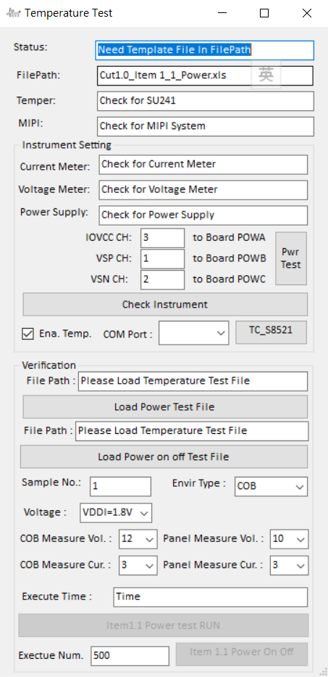
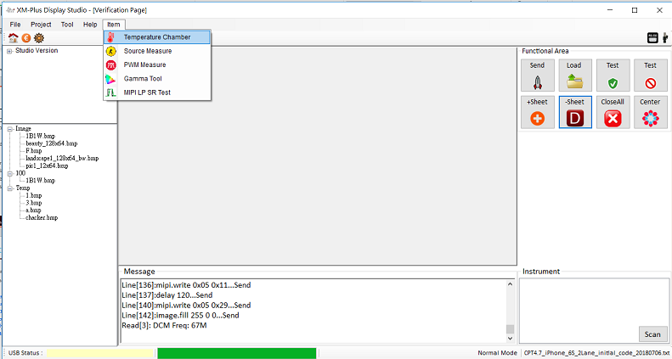
How to open XM display studio for chamber test
Please choice Item then press “Temperature chamber” , as below.

Slide 19
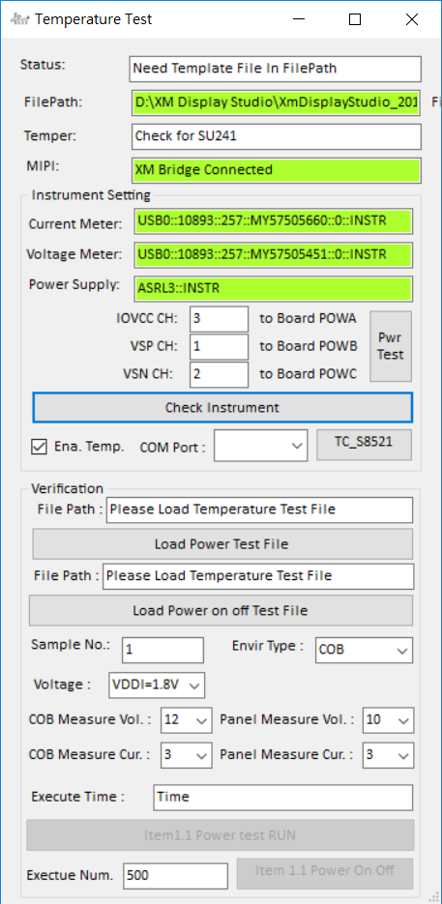
Check Instrument Status - 1
Please press button “Check Instrument” we will see XM Bridge Connected、 Current Meter and Voltage Meter show alias name and power supply show alias name, as below.
successful

Slide 20
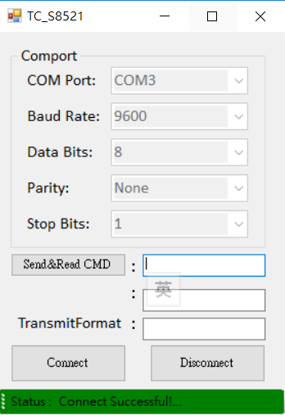
Check Instrument Status - 2
Please choice COMPORT and press button “TC_S8251” to connect , if Connect is successful then it will show
status : Connect successful!...
Step 3. close the form
Note : if checkbox is not checked, then means test without chamber machine
Step 2. Press button to
Connect Chamber machine
Com3
Step 1 . Choice Comport

Slide 21
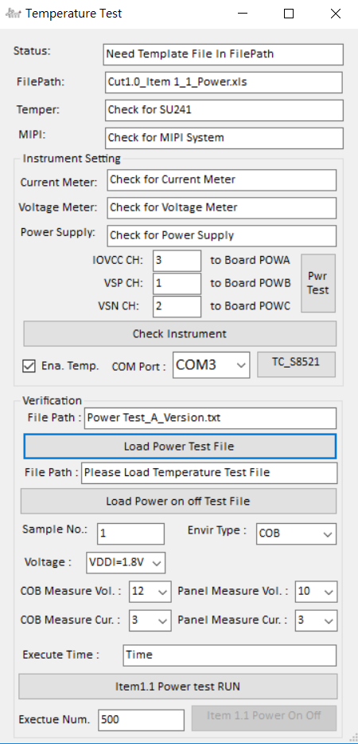
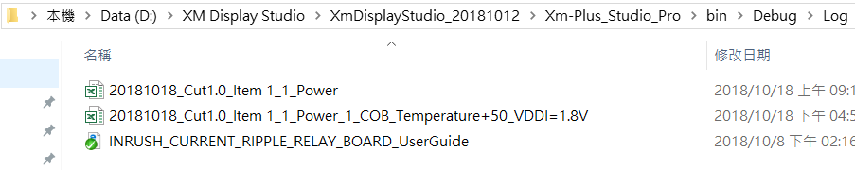
Chamber Test - 1
For power test RUN ：Please press button to load file then press button to start chamber test. XM display studio ( tool ) Auto save excel file ( one temperature have one excel file and so on.) to document “log” As below.
Step 1 . Press button to load chamber test file
Step 2 . Set by user-defined
Step 3. Press button to Start chamber test

Slide 22
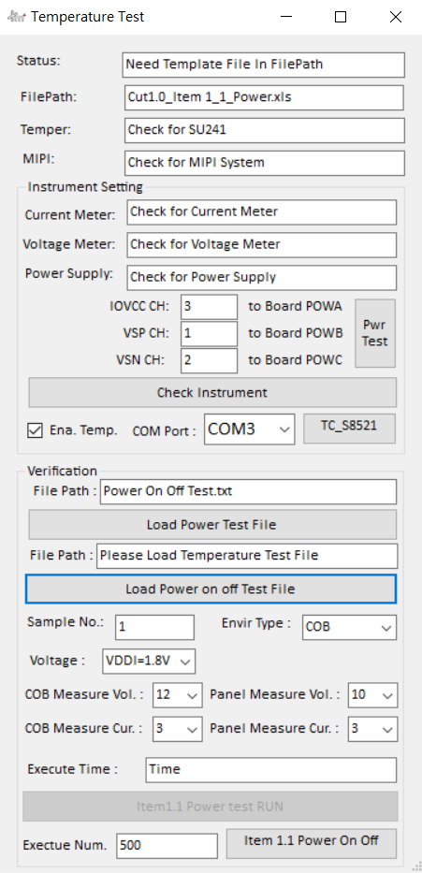
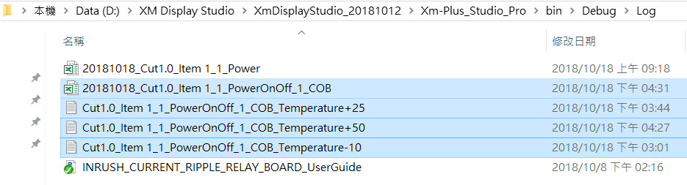
Chamber Test - 2
For power ON OFF ：Please press button to load file then press button to start chamber test. XM display studio ( tool ) Auto save txt file ( one temperature have one txt file and so on.) finally , save all txt to one excel file to document “log” As below.
Excel file
Txt file
Step 1 . Press button to load chamber test file
Step 2 . Set by user-defined
Step 3. Press button to Start chamber test

Slide 23
谢谢大家 !

